Slide 1
2/22
Technology Review
Sarah Alamdari, Ted Cohen, Robert Masse, Nicole Thompson
Notes:
Dash announcement !
https://medium.com/@plotlygraphs/introducing-dash-5ecf7191b503

Slide 2
Background
Looking at different Data Visualization Tools
Our Data Vis Problem: Cycling data have a lot of components that can be extracted and visualized
dQ/dV
Voltage, Capacity (Retention), Efficiency, Energy (Power), Resistance vs Cycle
Peak Descriptors (Number, Location, Height, Width) vs Cycle
Requirements
Interactive
Web Interface
Python based tools
Notes:
Interactive (choose axes, pick sections of data (time frames or voltage axis)
Users should be able to choses what components their interested in understanding

Slide 3
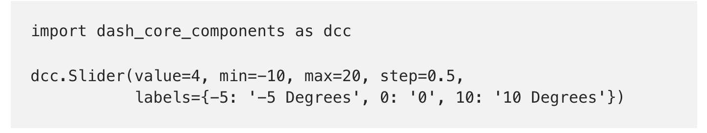
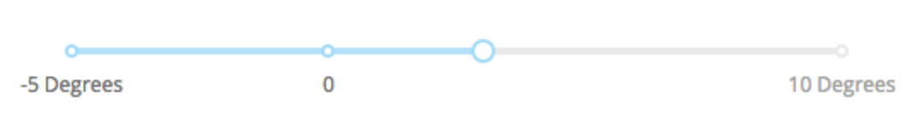
How it Works
Dash is a Python framework for building analytical web applications
Dash provides a Python interface to a rich set of interactive web-based components
Java components are from React.js
Uses Flask to run web servers (widely used by Python users)
Open Source MIT License
Dash makes it dead-simple to build a GUI around your data analysis code” – Dash Launch Announcement
Notes:
Interfaced plotly (python graph interface) with react.js (a java script library) and created Dash which is a completely python based way of creating interactive plots
Flask is a microframework for python
React.js the Javascript user-interface library written and maintained by Facebook

Slide 4
Appeal
Only need to know python for interactive plots
All aspects of Dash are open source and widely used by the Python community
Well documented on stackoverflow, github
Respond to issues on Github quickly (24 hrs)
Might be better for bigger datasets based on user testimonials

Slide 5
Appeal – Only takes ~150 lines of code to get cool visualization!

Slide 6
Drawbacks
Dash is a newer release from Plotly (2017)
Fewer Features and Capabilities compared to other frameworks (i.e Bokeh which has been around since 2013)
Dash is not interactive with Jupyter Notebooks
Limited Interactions with Graph due to no java scripting
i.e Can not pan multiple graphs
Notes:
Panning multiple graphs example: https://bokeh.pydata.org/en/latest/docs/user_guide/interaction/linking.html

